Slide 1






WAVECON TELECOM
ANALYSIS
Presented By –
Sanchay Rohad

Slide 2


INTRODUCTION
Welcome to Wavecon, a leading player in the telecommunications industry known for i ts stellar service.
We' re thrilled to announce the launch of our highly anticipated 5 G service, marking a significant milestone in our product l ineup.
As we delve into this exciting chapter, we' re keen to swiftly evaluate the success of the 5 G rollout, with a focus on Metrics l ike customer acquisition and service speed.
Additionally, we' re eager to track the performance of our different 5 G plans since their introduction.

Slide 3


OBJECTIVES
What is the impact of the 5G launch on our revenue?
Which KPI is underperforming after the 5G launch?
After the 5G launch, which plans are performing well in terms of revenue? Which plans are not performing well?
Is there any plan affected largely by the 5G launch? Should we continue or discontinued that plan
Is there any plan that is discontinued after the 5G launch? What is the reason for it?

Slide 4






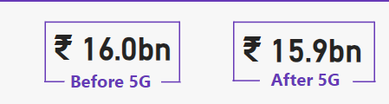
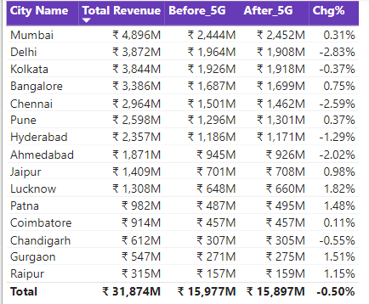
IMPACT ON REVENUE
The total revenue after the 5G launch is reported as 15.9bn compared to 16.0bn before 5G, indicating a slight decrease of 0.50%.
Cities like Mumbai and Jaipur have shown an increase in revenue post-5G, with changes of +0.31% and +0.98% respectively.

Slide 5










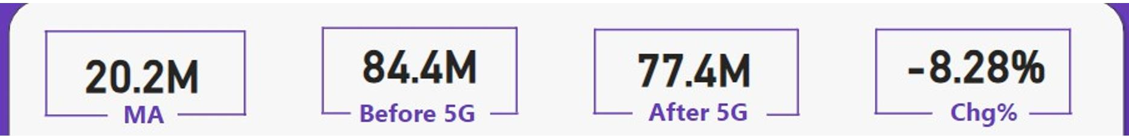
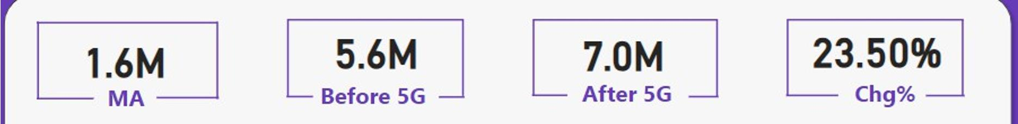
UNDERPERFORMING KPIS AFTER 5G LAUNCH
Total Active Users (TAU)
Total Unsubscribe Users (TUsU)

Slide 6


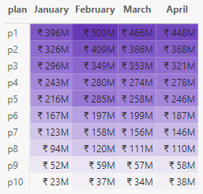
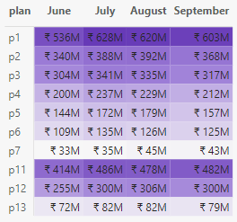
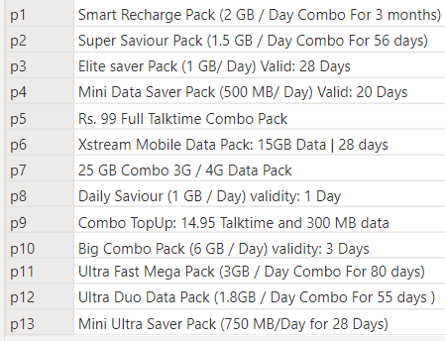
PERFORMANCE BY PLANS
Before 5G
After 5G
Plan Description
Plans Performing Well: P1, P2, P3, P11 Plans Not Performing Well: P7, P13

Slide 7












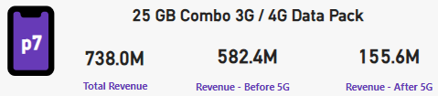
PLANS AFFECTED LARGELY BY 5G LAUNCH
Plans Affected: P7
There is a substantial decrease in total revenue from 582.4M before 5G to 155.6M after 5G.

Slide 8










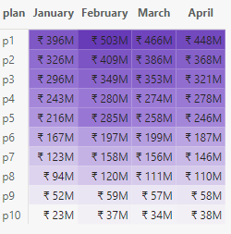
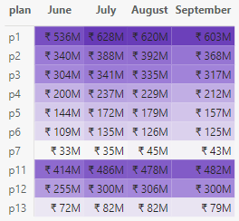
DISCONTINUED PLANS AFTER 5G LAUNCH
Before 5G After 5G
New Plans were introduced in place of P8,P9 and P10
New Plans:
Discontinued Plans:
P8
P9
P10
P11
P12
P13

Slide 9
THANK YOU

